Slide 1

5. Lateral movement (east-west)
Refers to the ability of an attacker to move across the network sideways, from server to server or from application to application, thus expanding the attack or moving closer to valuable assets.
Notes:
Tyrion Lannister
Nobody see you or they think you are an expected behavior

Slide 2


6. Segregation of duties
Restricting the privileges that users have in access to systems and data, and limiting the ability of one privileged user to cause damage either by mistake or maliciously.

Slide 3

7. Data exfiltration
Unauthorized extraction of data from your systems, might result in sensitive data being accessed by unauthorized parties.
Notes:
Lord Varys

Slide 4


8. Denial of service (DoS)
Is an attack vector whose purpose it is to deny your users from getting service from your systems
Notes:
Wildfire is a volatile green liquid that burns for a long time.
Here under King’s Landing
The wildfire stored under the Great Sept of Baelor is ignited during the Sept trial of Cersei and Loras

Slide 5

9. Advanced persistent threat (APT)
Sophisticated attacks that often take many months to unravel.
Notes:
Jorah Mormont -> greyscale

Slide 6
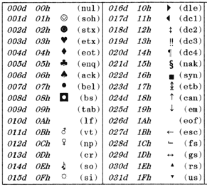
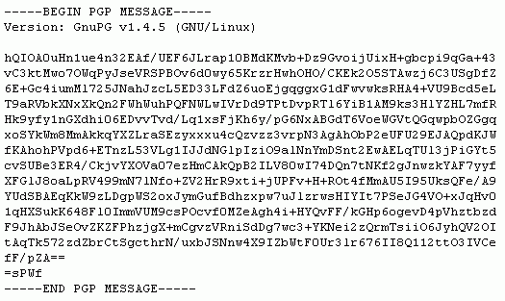
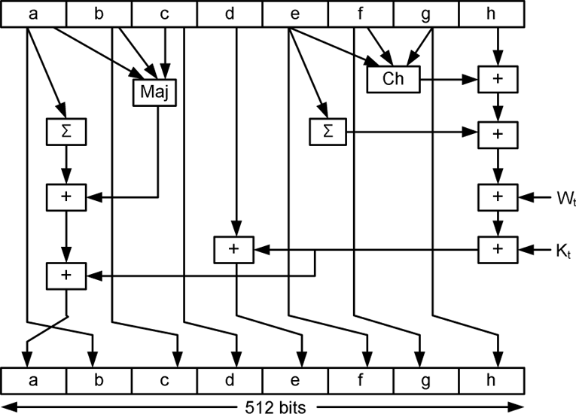
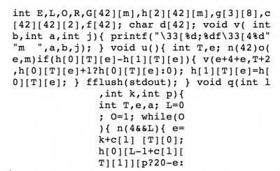
10. Hashing vs Encoding vs Encryption vs Obfuscation
Encoding is for maintaining data usability and can be reversed by employing the same algorithm that encoded the content: ASCII, Unicode, URL Encoding, Base64
Encryption is for maintaining data confidentiality and requires the use of a key (kept secret) in order to return to plaintext: AES, Blowfish, RSA
Hashing is for validating the integrity of content by detecting all modification thereof via obvious changes to the hash output: SHA, MD5, MD4 etc.
Obfuscation is used to prevent people from understanding the meaning of something, and is often used with computer code to help prevent successful reverse engineering and/or theft of a product’s functionality: JavaScript Obfuscator, ProGuard

Slide 7

Last but not least!

Slide 8

Thanks
Thanks
I used next resources as idea and reference (links available in blyx.com):
http://www.infoworld.com/article/3144362/devops/10-key-security-terms-devops-ninjas-need-to-know.html
https://danielmiessler.com/study/encoding-encryption-hashing-obfuscation/#encoding
https://blog.instant2fa.com/how-to-build-a-wall-that-stops-white-walkers-fantastic-threat-models-ef2dfa7864a4#.j1zj36pk8
Notes:
http://www.infoworld.com/article/3144362/devops/10-key-security-terms-devops-ninjas-need-to-know.html
https://danielmiessler.com/study/encoding-encryption-hashing-obfuscation/#encoding
https://blog.instant2fa.com/how-to-build-a-wall-that-stops-white-walkers-fantastic-threat-models-ef2dfa7864a4

